Slide 1
POLARIZED TIME INERTIA
A Relational Framework for Unifying Gravity,
Quantum Mechanics, and Cosmological Structure
David James Milton Hansen
Revised Edition — March 2026

Slide 2
The Central Problem of Modern Physics
General Relativity
Quantum Mechanics
Smooth spacetime manifold
Gravity = curvature of space
Deterministic evolution
Confirmed: GW, black hole imaging
Discrete, quantized properties
Probabilistic wave functions
Observer-dependent outcomes
Confirmed: every particle experiment
⚠ These two theories are mutually incompatible
Polarized Time Inertia | Hansen 2026

Slide 3
PTI’s Answer
Both GR and QM are valid projections of a deeper relational structure.
One ontological primitive: the relational comparison
One emergence hierarchy: Time → Space → Energy → Mass
Three axioms: each grounded in established physics
GR is the continuum limit.
QM is the microscopic description.
Both emerge from the same relational engine.
Polarized Time Inertia | Hansen 2026

Slide 4
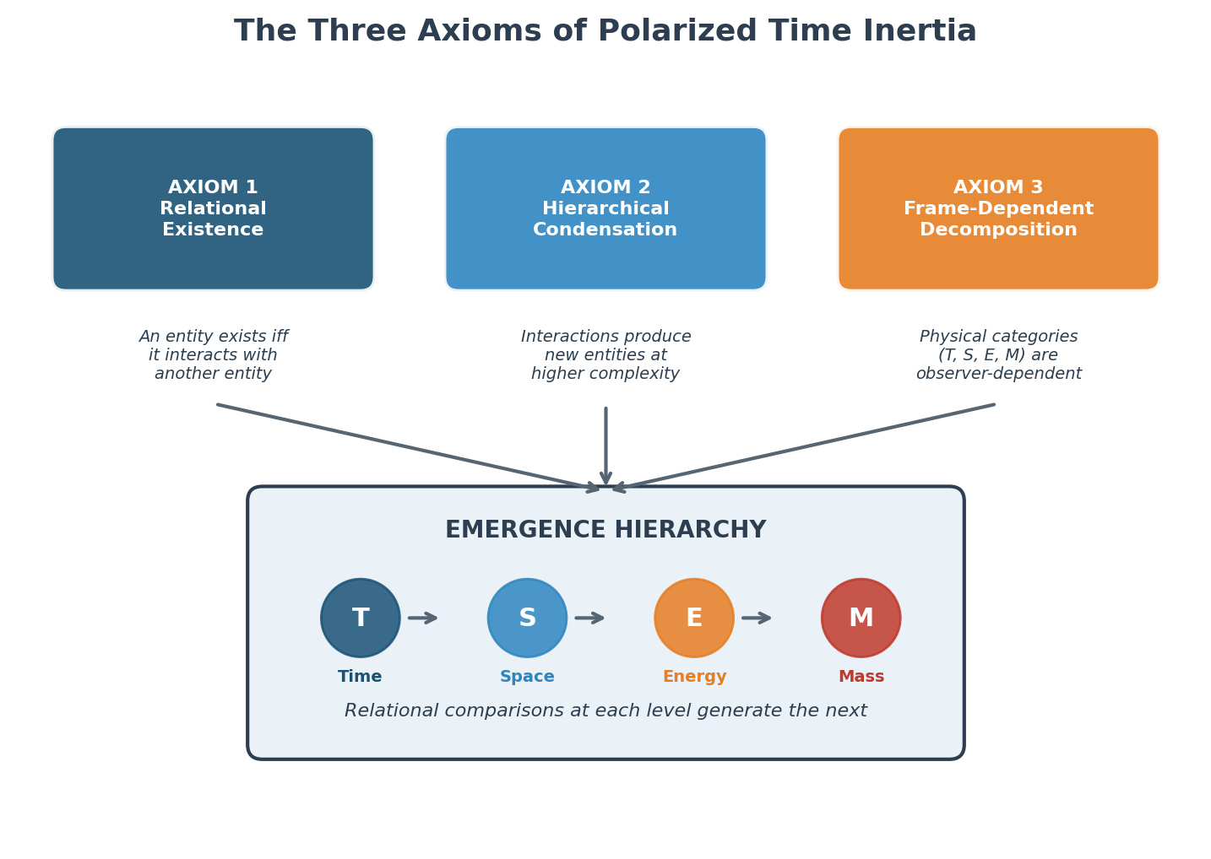
The Three Axioms
Polarized Time Inertia | Hansen 2026

Slide 5
Axiom 1: Relational Existence
An entity exists if and only if it interacts with at least one other entity.
Existence is constituted by relation, not by substance.
∃x ⇔ ∃y : I(x, y) ≠ ∅
Established Physics Basis
Novel Extension
Rovelli’s Relational QM (1996)
Wheeler’s “It from Bit” (1990)
Causal Set Theory (Bombelli 1987)
Not just quantum states but all entities — including spacetime itself — are constituted by relations. An unobserved, non-interacting entity has no being.
Polarized Time Inertia | Hansen 2026

Slide 6
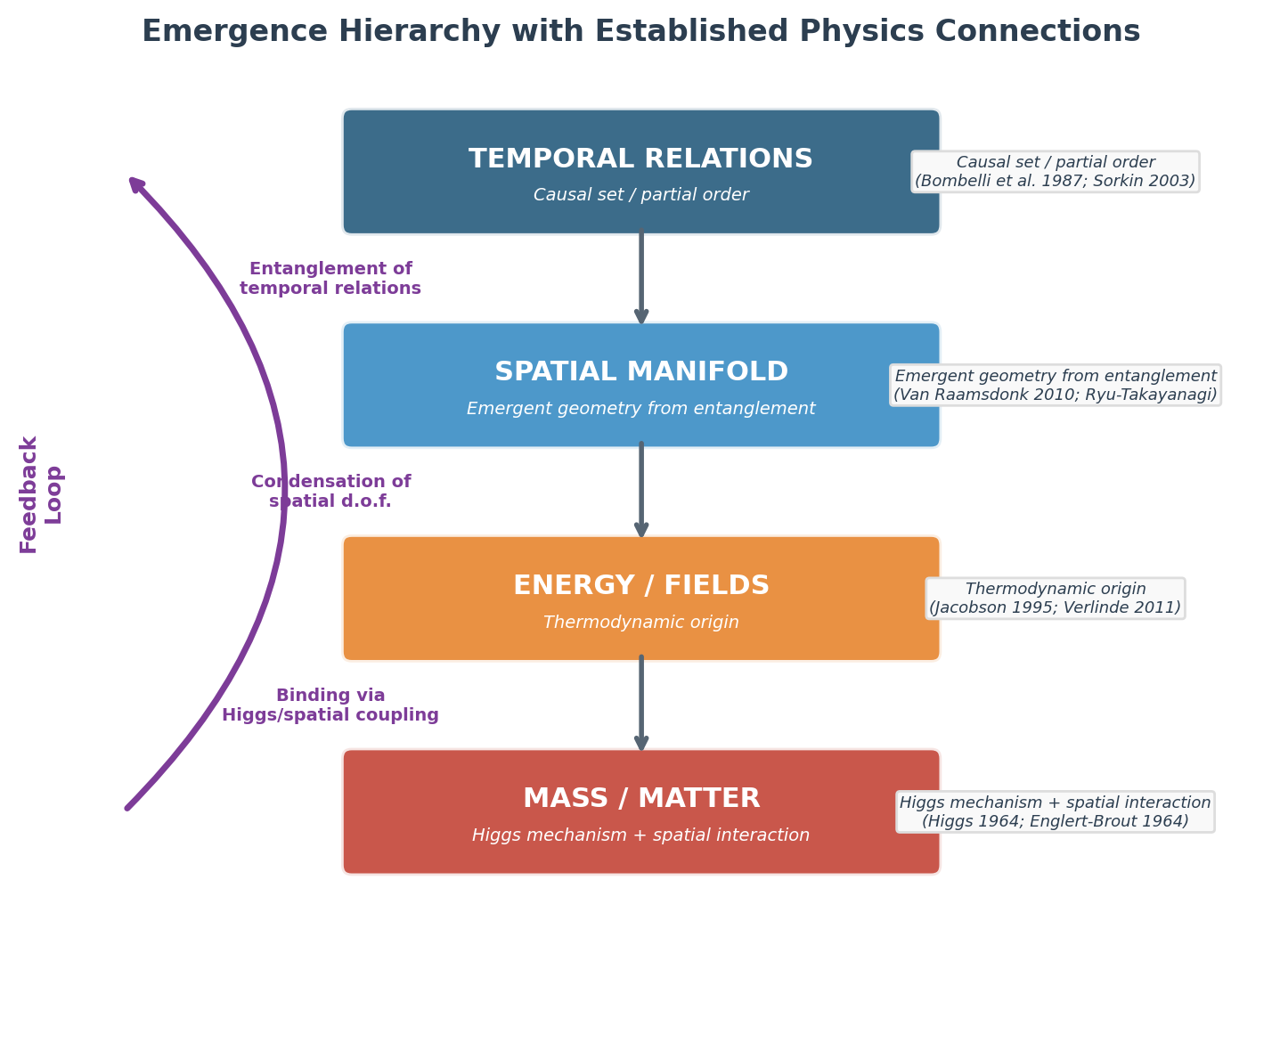
Axiom 2: Hierarchical Condensation
Interactions produce new entities at higher complexity.
T ⊗ T → S S ⊗ T → E E ⊗ S ⊗ T → M
Polarized Time Inertia | Hansen 2026

Slide 7
Axiom 3: Frame-Dependent Decomposition
The decomposition of reality into T, S, E, M depends on the observer’s frame.
There is no absolute decomposition. The relational structure R is frame-independent.
Established Physics Basis
What This Means
Lorentz covariance (space/time mix under boosts)
ADM formalism (foliation-dependent split)
E = mc² (energy/mass interconversion)
Unruh effect (frame-dependent particles)
A photon (null frame), a massive particle (timelike frame), and an accelerated observer (Rindler frame) decompose the same relational structure into fundamentally different physical realities. None is more “real” than another.
Φ_F(R) = P_F · R
Polarized Time Inertia | Hansen 2026

Slide 8
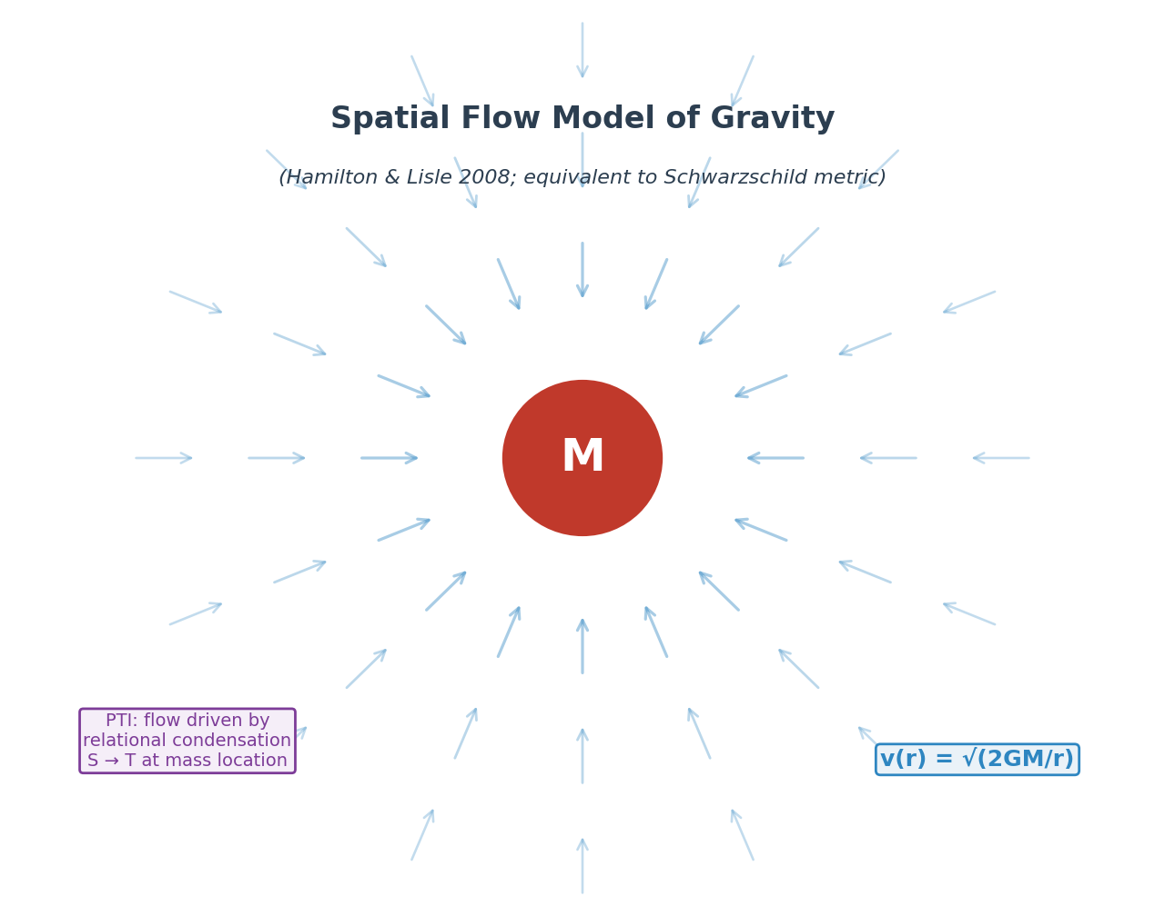
Gravity: Space Flows Into Matter
Key Insights
Space flows inward toward mass at v = √(2GM/r)
Mathematically equivalent to Schwarzschild metric (Hamilton & Lisle 2008)
PTI mechanism: mass converts spatial degrees of freedom back to temporal relations
Discrete at Planck scale → natural path to quantum gravity
Reproduces inverse-square law, perihelion precession, frame dragging
Polarized Time Inertia | Hansen 2026

Slide 9
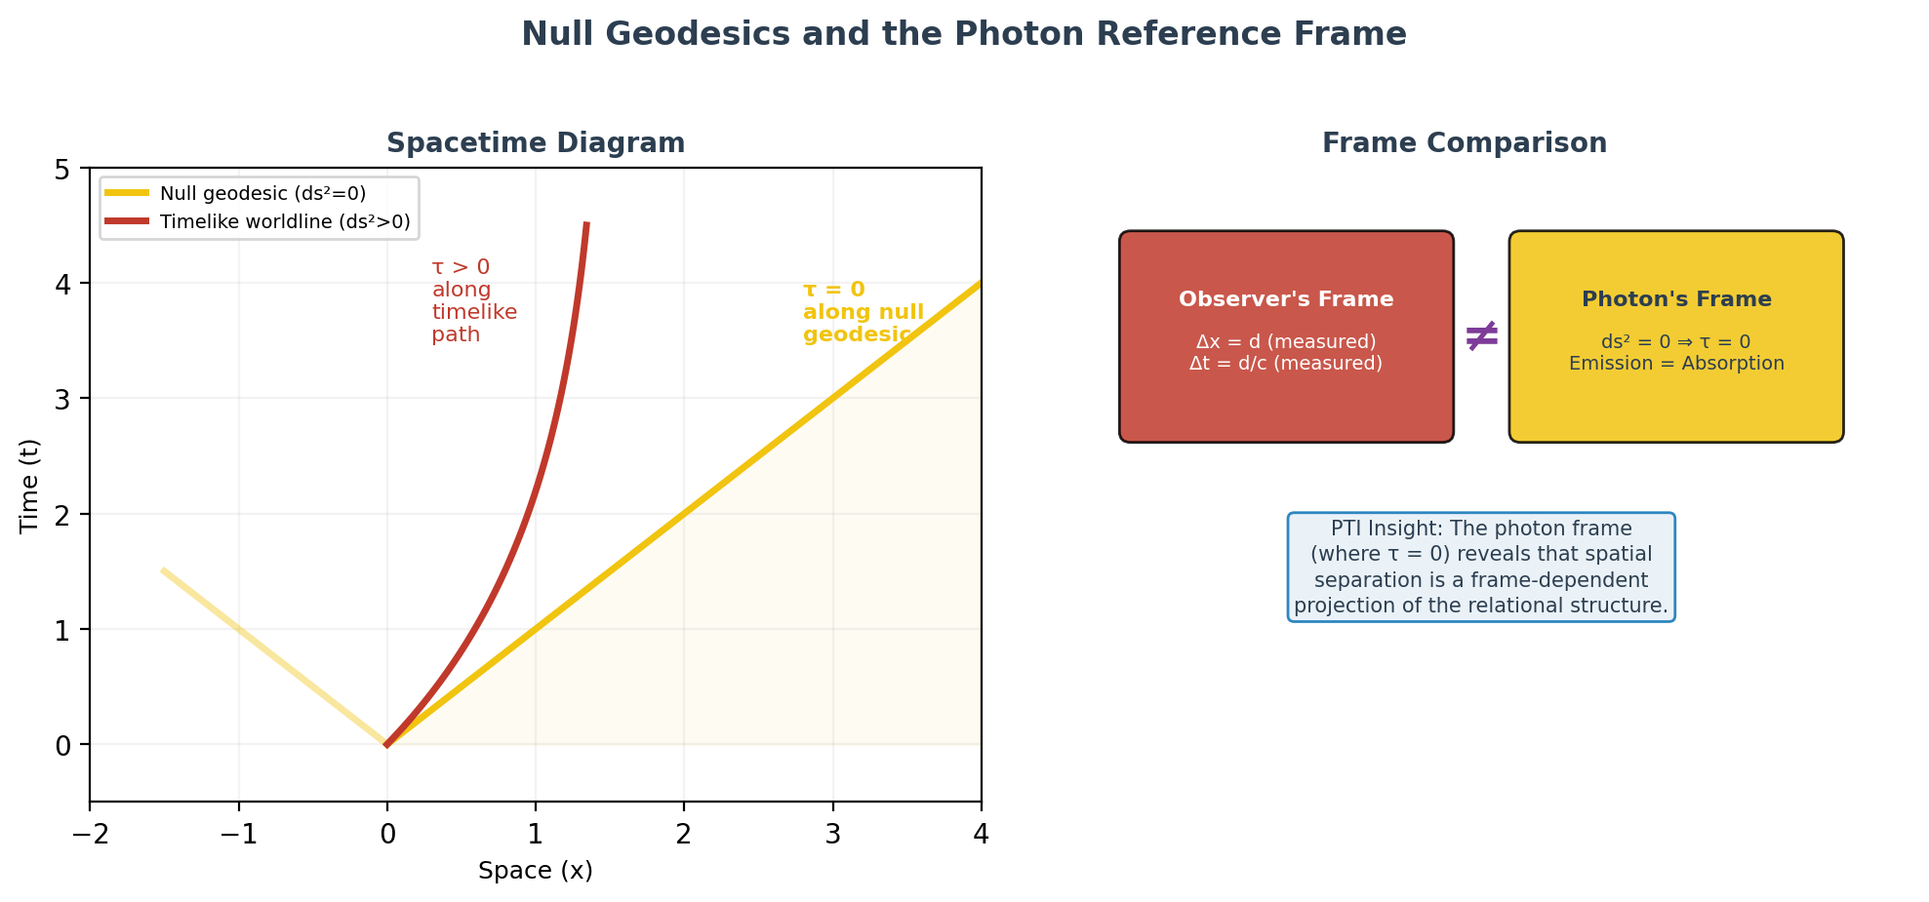
Photons and the Null Frame
Polarized Time Inertia | Hansen 2026

Slide 10
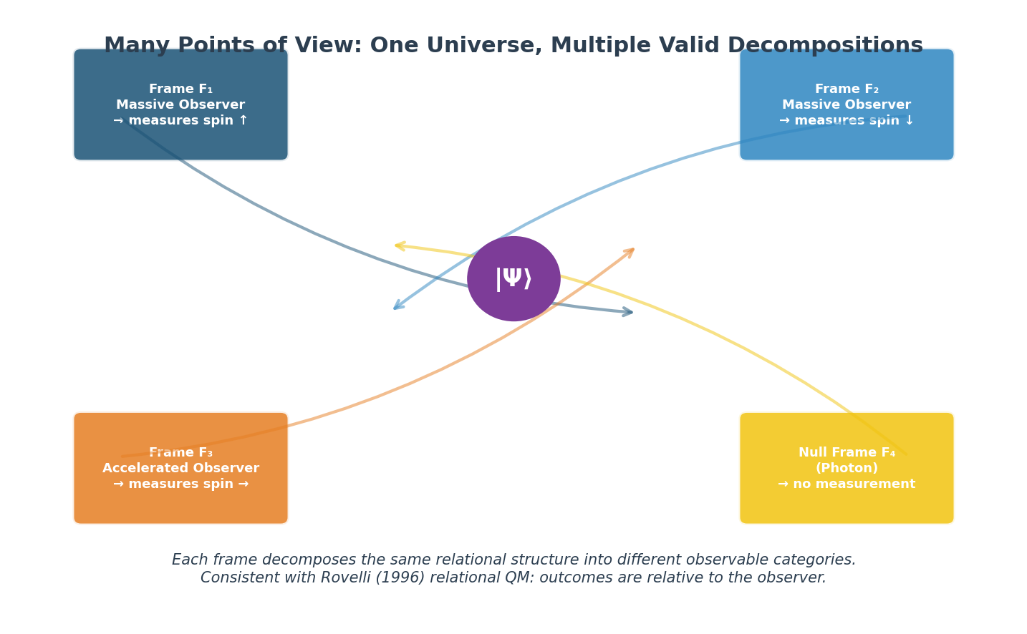
Many Points of View
Replacing Many Worlds

Slide 11
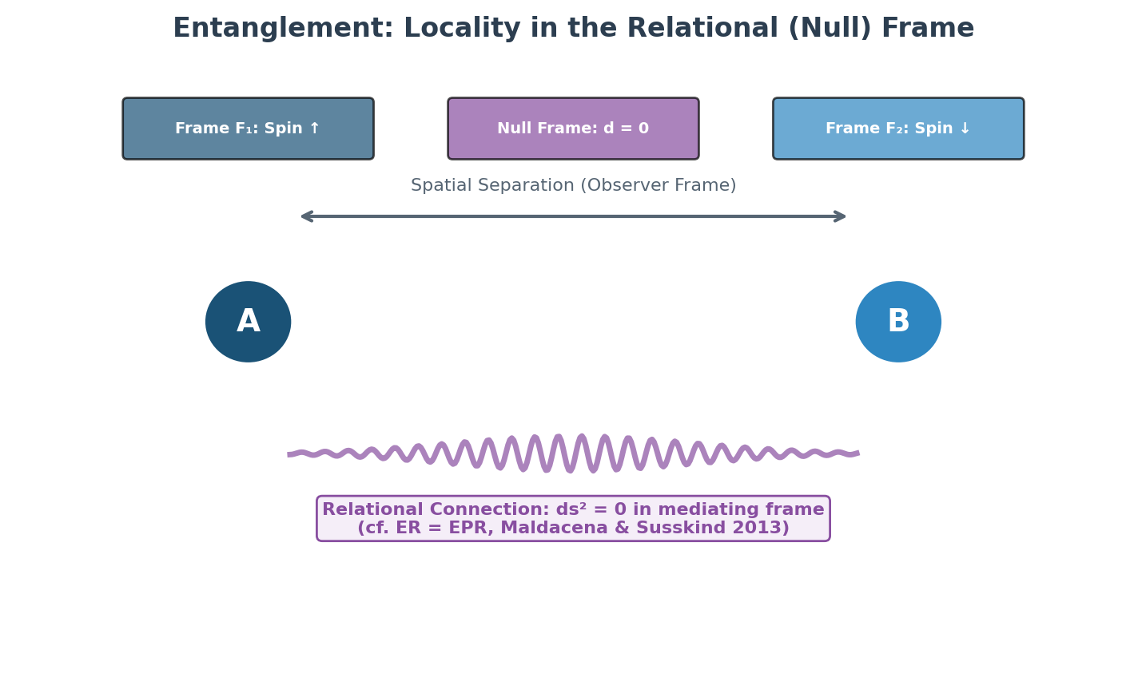
Entanglement: The Illusion of Distance
In the null frame connecting entangled particles, ds² = 0. There is no distance.
“Spooky action at a distance” is locality in the mediating frame. (cf. ER = EPR, Maldacena & Susskind 2013)
Polarized Time Inertia | Hansen 2026

Slide 12
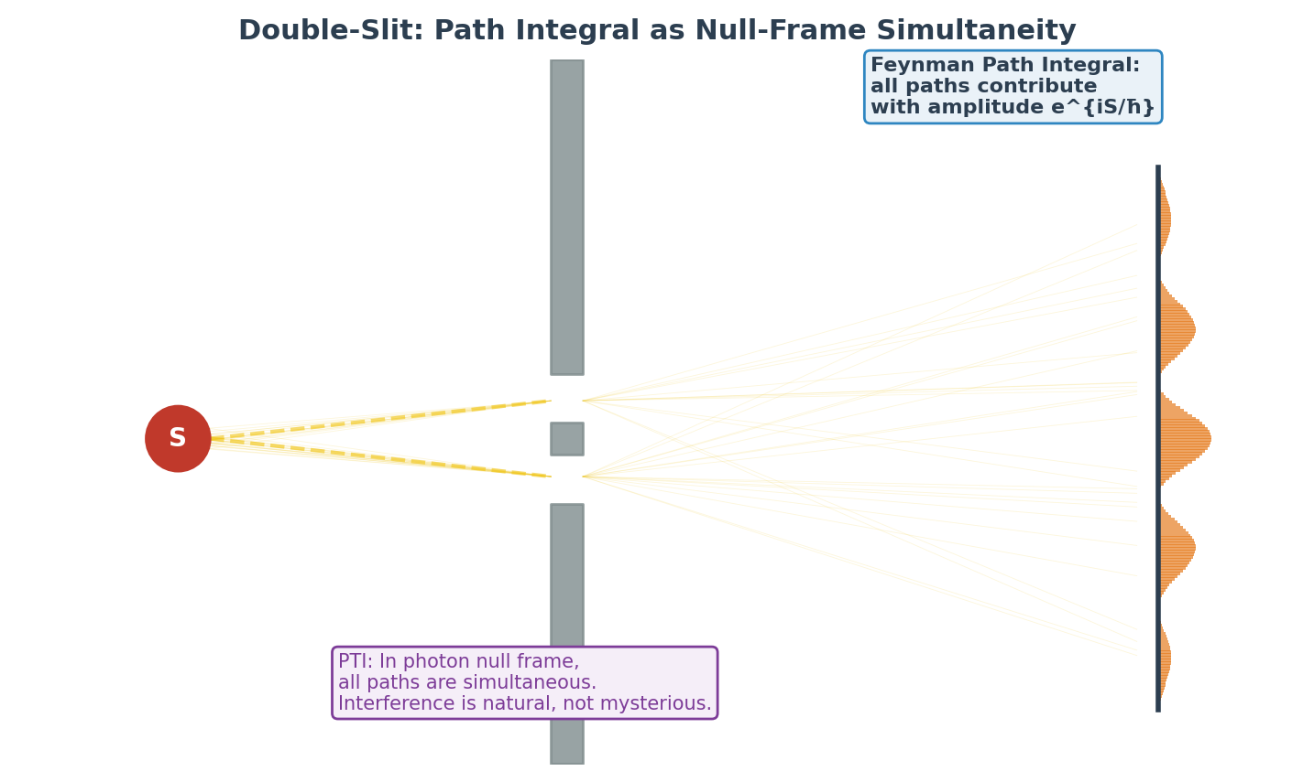
The Double-Slit Experiment
Polarized Time Inertia | Hansen 2026

Slide 13
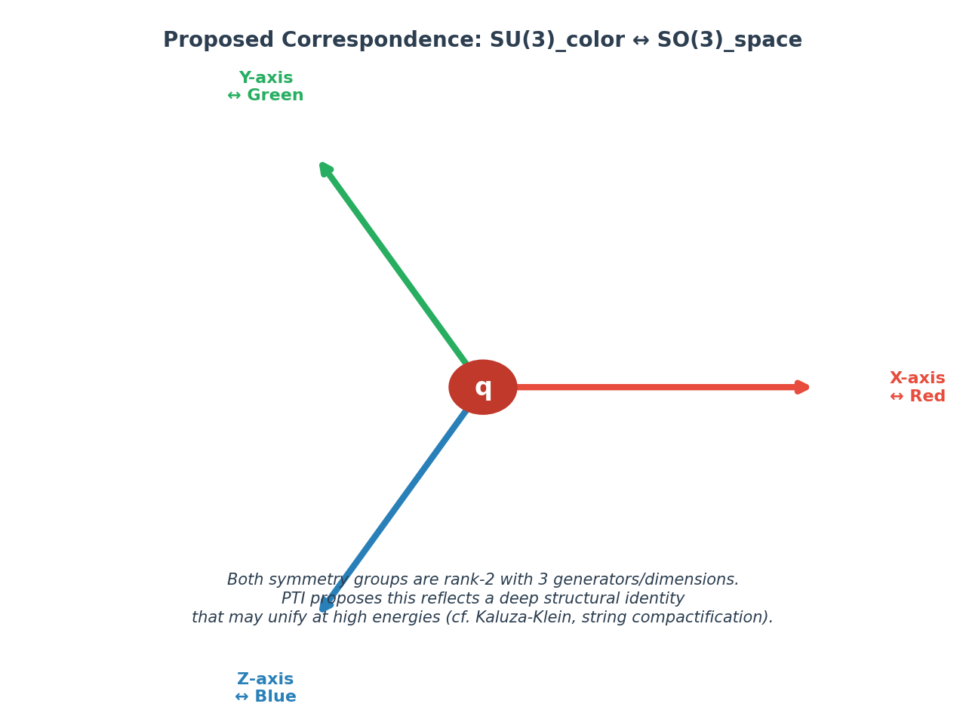
The Color-Space Correspondence
Polarized Time Inertia | Hansen 2026

Slide 14
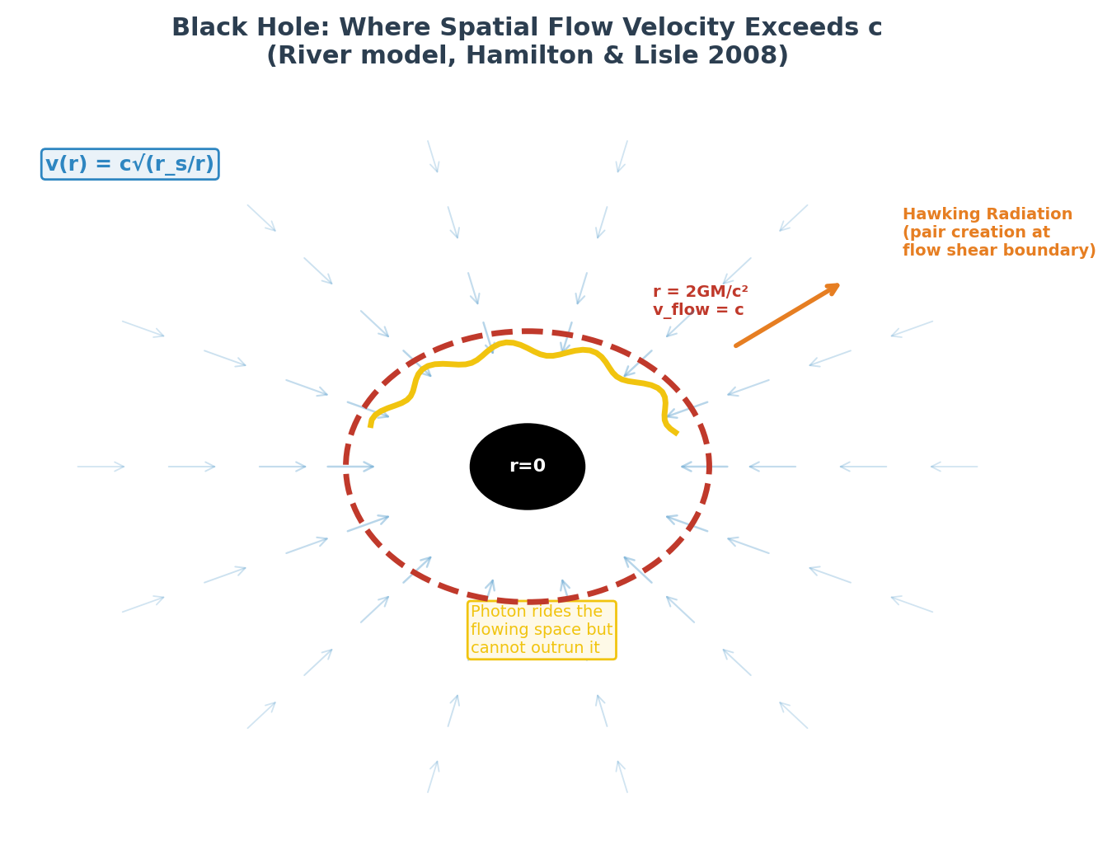
Black Holes
Event Horizon
The surface where spatial flow velocity = c.
Inside, space flows faster than light can propagate.
Light Trapping
Photons ride the flowing space like leaves on a river. They cannot escape because the river flows faster than they can swim.
Hawking Radiation
Extreme flow shearing at the horizon splits the relational structure, creating particle pairs. Information is preserved.
r_s = 2GM/c² : v(r_s) = c

Slide 15
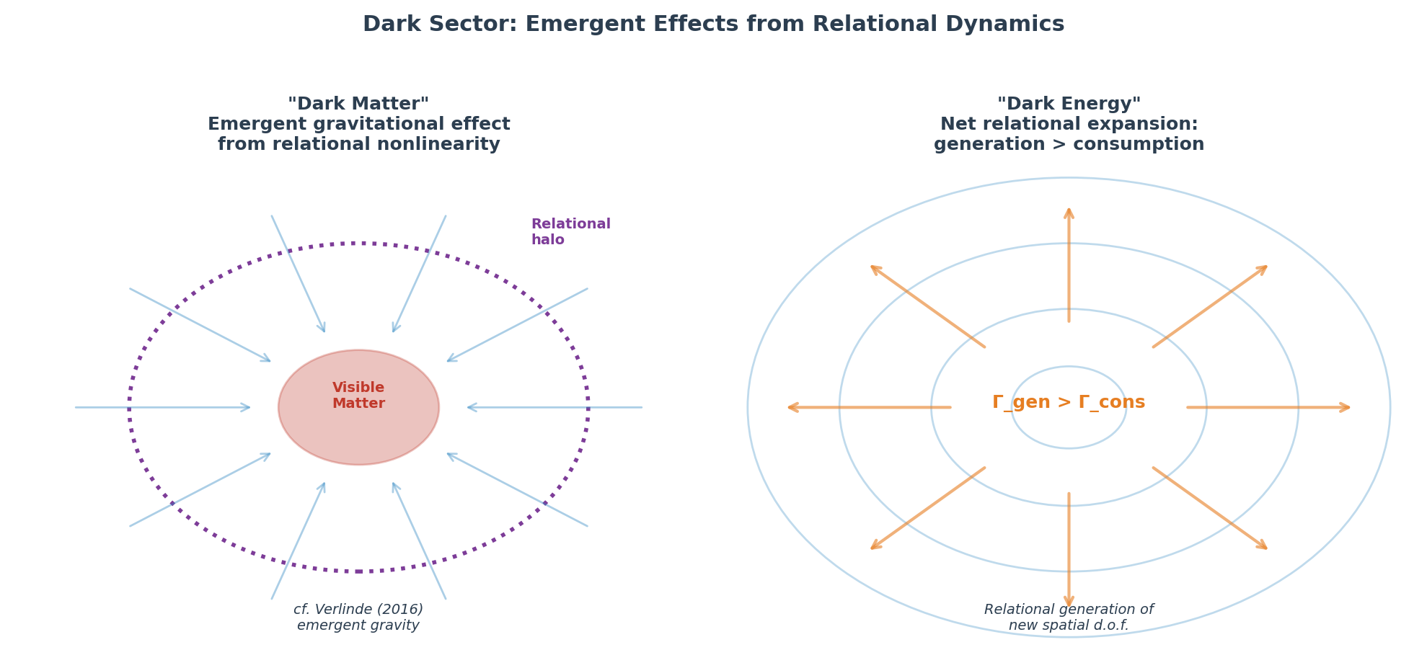
Dark Matter & Dark Energy
Polarized Time Inertia | Hansen 2026

Slide 16
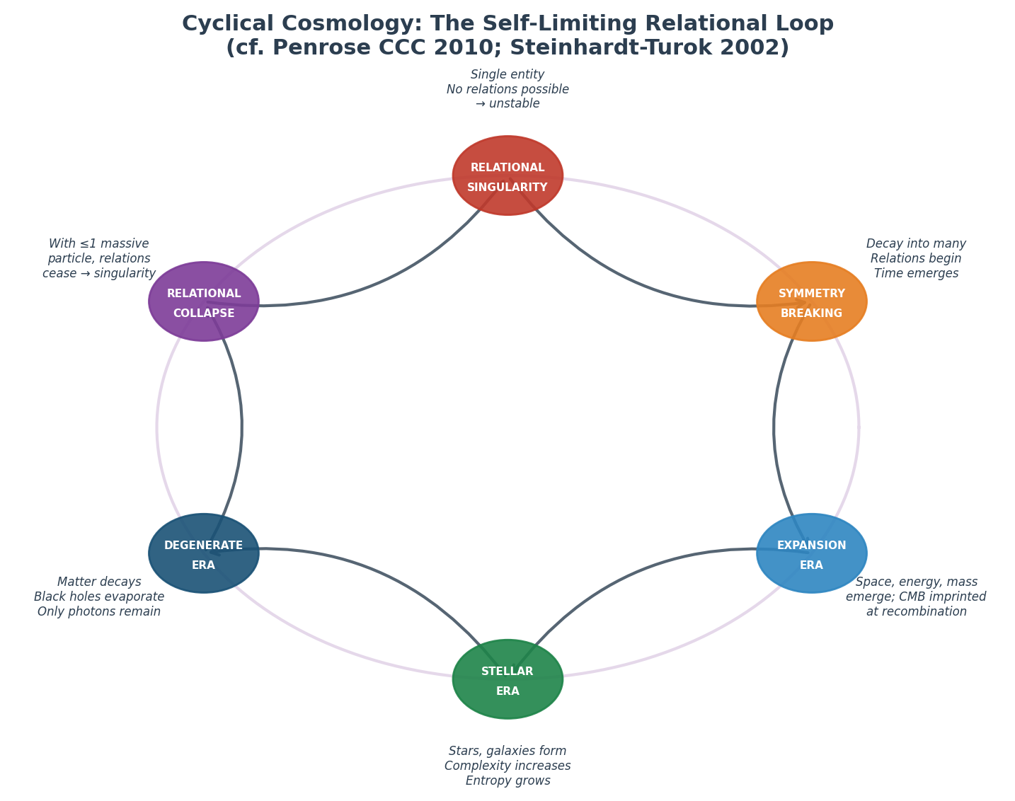
The Cyclical Singularity
The Self-Limiting Loop
1. All matter decays to photons
2. Space and time lose meaning
3. Last particle absorbs all energy
4. Single entity violates Axiom 1
5. Unstable → decays into many
6. New Big Bang
CMB: the thermal fingerprint of the first epoch of relational comparison. ΔT/T ~ 10⁻⁵ from Planck-scale granularity.

Slide 17
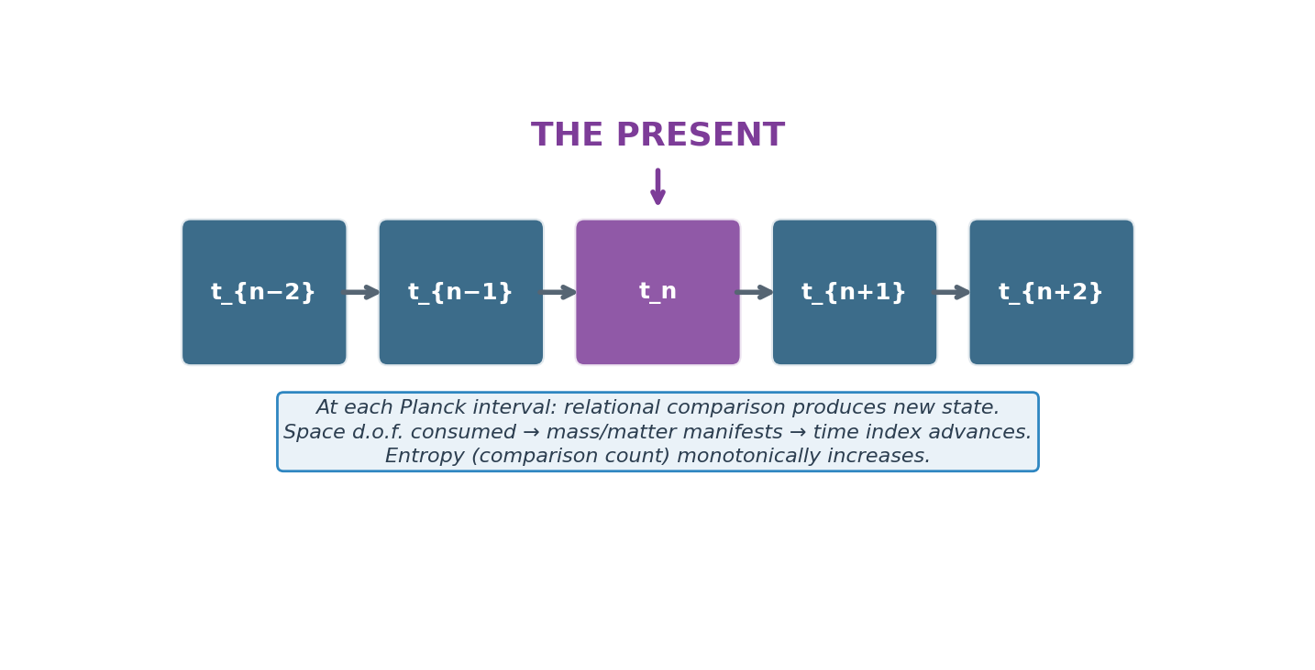
The Engine of the Present
The arrow of time = the direction in which the relational comparison structure grows.
Entropy = complexity of the relational structure. S = k_B ln(Ω_relations)
Polarized Time Inertia | Hansen 2026

Slide 18
Testable Predictions
Prediction | Test | Tier
No dark matter particle | XENONnT, LZ, PandaX null results | 1
Zero vacuum dispersion | Fermi-LAT, CTA gamma-ray bursts | 1
Planck-scale gravity noise | LIGO high-f analysis, Einstein Tel. | 1–2
Double-slit decoherence curve | Tabletop optics: exp vs √(1−D²) | 1
Proton decay (finite lifetime) | Hyper-Kamiokande, JUNO, DUNE | 1–2
QCD color-space coupling | Asymmetric lattice QCD simulations | 1
CMB cycle residual | Planck data reanalysis | 1
Dynamical dark energy | DESI, Euclid, Roman H(z) | 1–2
A theory that predicts everything and forbids nothing is not a theory.
PTI forbids: dark matter particles, vacuum dispersion, absolutely stable protons, arbitrarily smooth gravity.
Polarized Time Inertia | Hansen 2026

Slide 19
Built on Established Physics
Causal Set Theory
Discrete temporal partial order
Bombelli et al. 1987
Emergent Spacetime
Space from entanglement
Van Raamsdonk 2010
Thermodynamic Gravity
Einstein’s equations from δQ = TdS
Jacobson 1995
Relational QM
Frame-dependent quantum states
Rovelli 1996
ER = EPR
Entanglement ↔ wormholes
Maldacena & Susskind 2013
River Model
Gravity as spatial flow
Hamilton & Lisle 2008
PTI’s contribution: organizing all six into a single framework with one primitive and one hierarchy.

Slide 20
The universe is a self-referential
relational engine.
Not many worlds — many viewpoints.
Not static spacetime — a flowing conversion engine.
Not a one-time creation — a self-perpetuating loop.
David James Milton Hansen
March 2026

